Slide 1
ROCKBUSTER STEALTH LLC
Unleashing Rockbuster's Online Dominance
A strategic blueprint for video rental supremacy
INTRODUCTION
Name: Adewale Omotosho Amao
Data immersion Exercise 3.10
Date: 07.05.2024

Slide 2

Project Overview
Rockbuster Stealth LLC, formerly a global movie rental chain, aims to adapt to fierce competition from streaming giants like Netflix and Amazon Prime by launching an online video rental service
Goals
Leverage existing movie licenses to establish an online presence and maintain competitiveness.
Develop a strategic launch plan for the new online service, providing data-driven insights for decision-making.
Source: https://www.freepik.com/free-vector/

Slide 3

Strategic Objectives
Maximizing Revenue: Identify top and bottom-performing movies to optimize profitability.
Enhancing Customer Experience: Determine average rental duration to improve satisfaction.
Expanding Market Reach: Identify customer locations for targeted marketing.
Leveraging High-Value Customers: Recognize and engage high lifetime value customers.
Analyzing Geographic Performance: Assess sales variations across regions for targeted growth strategies.
Source: https://www.freepik.com/free-vector/

Slide 4
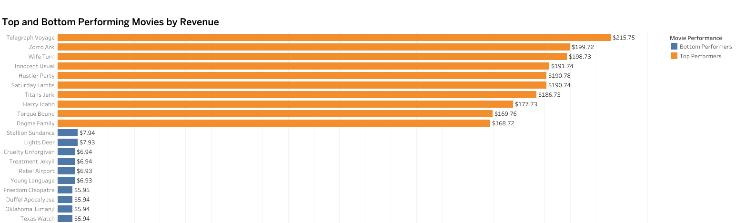
Revenue Champions and Underdogs: Top and Bottom Performing Movies
Lowest earners are ‘Texas Watch’ and ‘Oklahoma Jumanji’, suggesting Gaps in customer interest or marketing effectiveness
Top earners are ‘Telegraph Voyage’ and ‘Zorro Ark’, suggesting Adventure and drama are the popular genres.

Slide 5
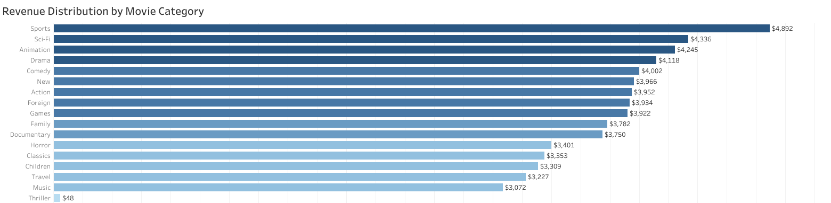
Genre Performance Analysis
‘Sports’ and ‘Sci-fi’ genres are top revenue drivers, indicating a strong interest in action-packed and futuristic content.
‘Comedy’ and ‘Documentary’ categories also contribute significantly to revenue, showcasing a diverse customer base with varied interests.

Slide 6
Rental Rundown: Average Duration Analysis
Average rental duration of all movies is 5 days.
PG has the highest average rental rate.
Maximum length of rented movies is 185 minutes.
All film ratings have 7 days maximum rental duration.

Slide 7
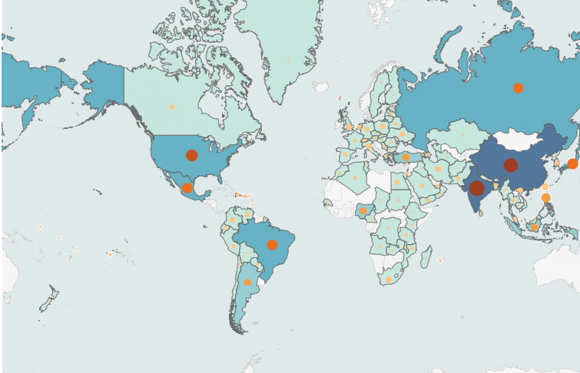



Customer Universe: Global Distribution and Revenue Powerhouses
Global Presence in 108 Countries with 599 Customers.
584 active customers and 15 inactive customers.
India and China Lead in Customers and Revenue.

Slide 8
Global Hotspot: Top 10 Countries Driving Revenue and Number of Customers
Top 10 countries drive revenue of $31,834 generated from 315 customers.
India and China Lead in Customers and Revenue.
Customer Base Drives Revenue: High number of customer coincide with revenue growth

Slide 9
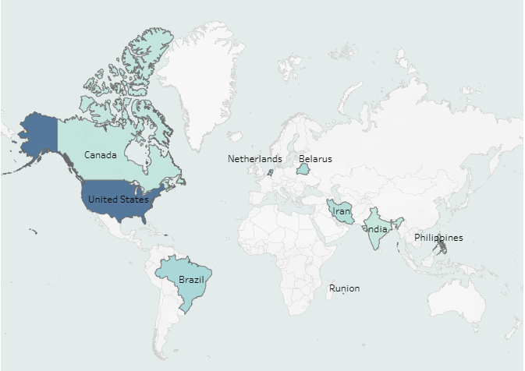

Loyalty Pays Off: Geographic Distribution of High-Value Customers
Top-revenue contributors (customers) are in the U.S. and Réunion.

Slide 10
High-Value Customer Spotlight
Eleanor Hunt from Réunion leads with $212 revenue.
Two high-value customers from the U.S.

Slide 11

Key Findings
Top-revenue movies: Telegraph Voyage & Zorro Ark - Adventure & Drama are customer favourites.
Bottom-revenue movies: Texas Watch & Oklahoma Jumanji – open marketing opportunities.
Top Revenue Genres: Sports & Sci-Fi - Action & Futuristic Preference.
Top Revenue Markets: India, China, USA - Priority for marketing & expansion.
Eleanor Hunt & Karl Seal are key revenue drivers. - Nurture Relationships for Growth.

Slide 12
Recommendations
Genre-targeted marketing with focus on Sports & Sci-Fi, using personalized promotions for customer retention.
Customize content and marketing strategies for customers in Top Markets like India, China, USA, to boost engagement & loyalty.
Reward high-value customers through loyalty programs to boost retention & lifetime value.
Invest to expand top genres and trim underperforming titles by regular update of movie catalogue based on customer preferences and market trends.
Implement a smart pricing based on film ratings & rental duration trends. Flexibility for Customer Preferences.

Slide 13
Launching Strategy for Rockbuster Online Video Services
Promote popular film categories and customer favourites.
Target high-value countries with largest customer base.
Customize offers per country according to customer behaviour and preferences.
Invest in a user-friendly interface to enhance user experience and engagement.
Track KPIs: Monitor acquisition, retention, revenue to assess launch strategy impact.

Slide 14
THANK YOU
ROCKBUSTER STEALTH LLC
Unleashing Rockbuster's Online Dominance
Tools: PostgreSQL for data management and Tableau for visualization.
Tableau Link: https://public.tableau.com/shared/4GT83FW4P?:display_count=n&:origin=viz_share_link
A strategic blueprint for video rental supremacy
Data immersion Exercise 3.10
Date: 07.05.2024

